Slide 1
Agritourism Development: From Knowledge to Practice
Carla Barbieri, PhD
Jose Cisneros
Professor & Extension Specialist
Professor & Director
Agritourism & Societal Well-being Lab
College of Natural Resources
CALS International Program
College of Agriculture and Life Sciences
Ag Entrepreneurship Workshop
April 25, 2023
Mostar, Bosnia and Herzegovina

Slide 2
What are we going to do?
Format: 5 modules:
Background (10 min.)
Hands-on activity (15 min.)
Group sharing (10 min.)
Part 3 (16:00 – 16:40):
Selling my Story
* Crafting my story.
Part 4 (16:45 – 17:25):
From Competition to ‘Coopetition’
* Identifying my local/regional coopetitors.
Part 1 (14:30 – 15:10):
The uniqueness of agritourism
* What are my resources?
Part 5 (17:30 – 18:15):
Wrapping up – Putting all pieces together
* My key learnings.
Part 2 (15:15 – 16:55):
The entrepreneurial mindset
* How will I incorporate creativity into my offerings?
Agritourism & Societal Well-being Lab

Slide 3
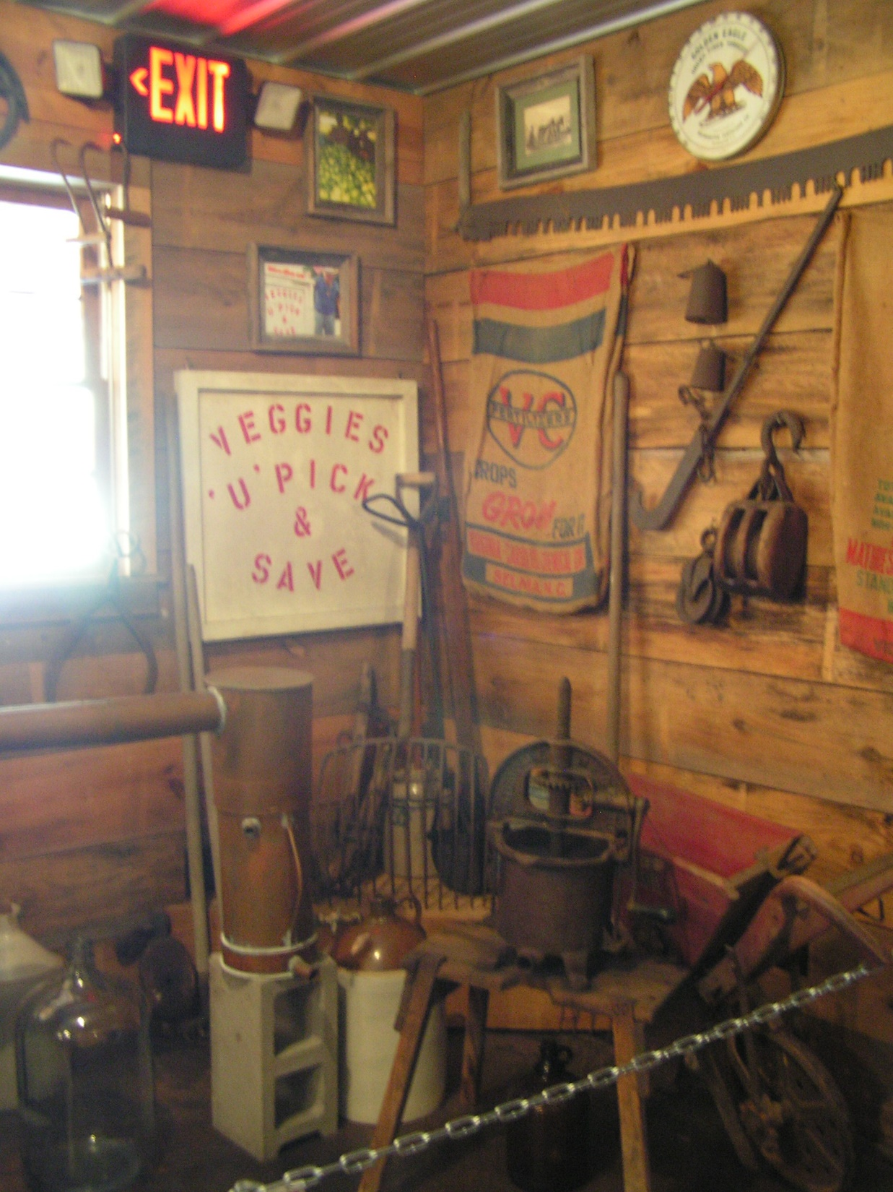
The Uniqueness of Agritourism
Part 1 (14:30 – 15:10)
Background [14:30 – 14:40]
Recap of agritourism
Uniqueness of agritourism
Activity [14:40 – 14:55]
What are my unique resources?
Group sharing [14:55 – 15:05]
Agritourism & Societal Well-being Lab

Slide 4
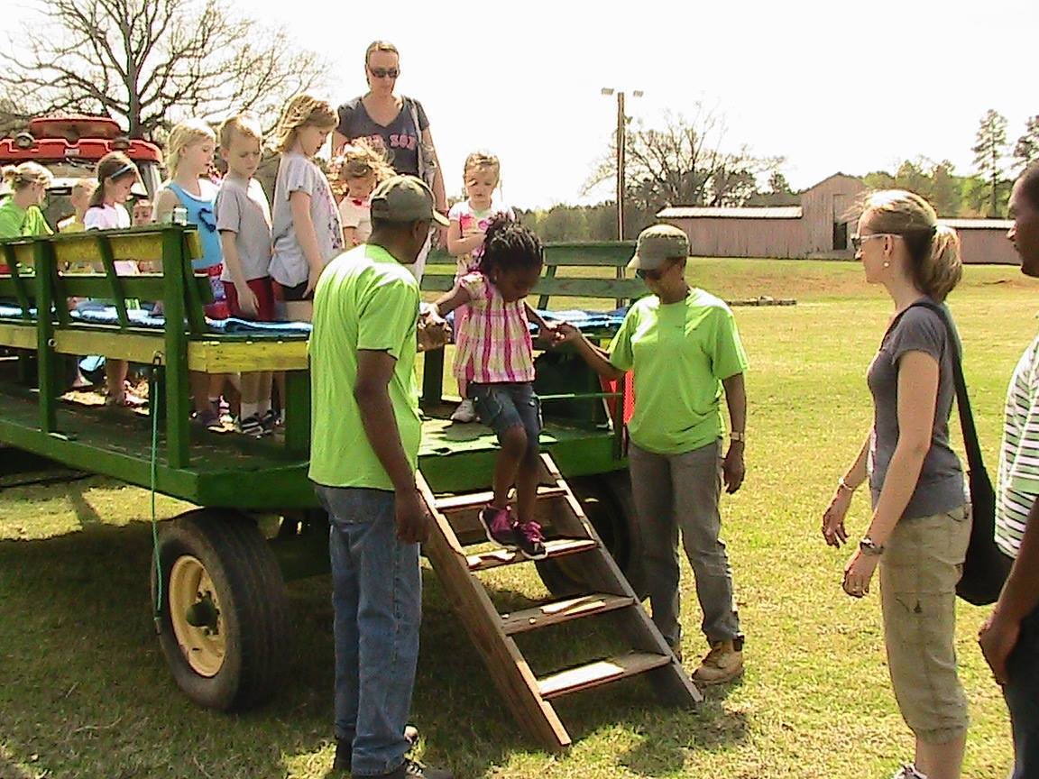
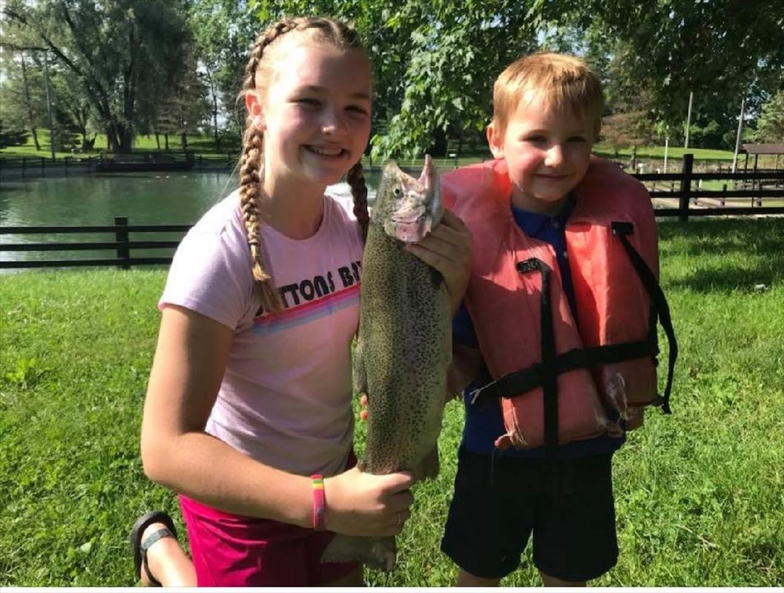
Recalling – What is Agritourism?
Activities carried out in working farms or other agricultural settings for leisure, recreation or education.
(Gil Arroyo, Barbieri & Rich, 2013)
Agritourism & Societal Well-being Lab
Notes:
Recap of agritourism – 5 minutes

Slide 5
Recalling – What is Agritourism?
Activities carried out in working farms or other agricultural settings for leisure, recreation or education.
Setting
Working ag setting (e.g., aquaculture, managed forests, nurseries)
Paid (e.g., activity fees)
2. Cost
Free
Direct (e.g., milk a cow)
3. Experience
Indirect (e.g., eat farm products)
Leisure (e.g., orchard tours)
Purpose
Recreation (e.g., rides)
Education (e.g., workshops)
(Gil Arroyo, Barbieri & Rich, 2013)
Agritourism & Societal Well-being Lab
Notes:
This is the meaning from visitors and farmers’ perspectives

Slide 6
Recalling – Agritourism as an Ag Enterprise
Enterprises developed on the farm to increase farm revenues or value.
Eight types of enterprises
Value
Added
Non Traditional Farming
2. Synergistic nature
Education
Innovative Marketing
Average: 3.8
Contracts & Services
3. Agritourism:
Constant expansion
Flexibility based on farm resources
Agritourism
Leases & Time Shares
Historic Preservation & Re-use
Barbieri et al., 2008
Agritourism & Societal Well-being Lab
Notes:
You can –or should– tie your agritourism to other on-farm enterprises you might have.

Slide 7
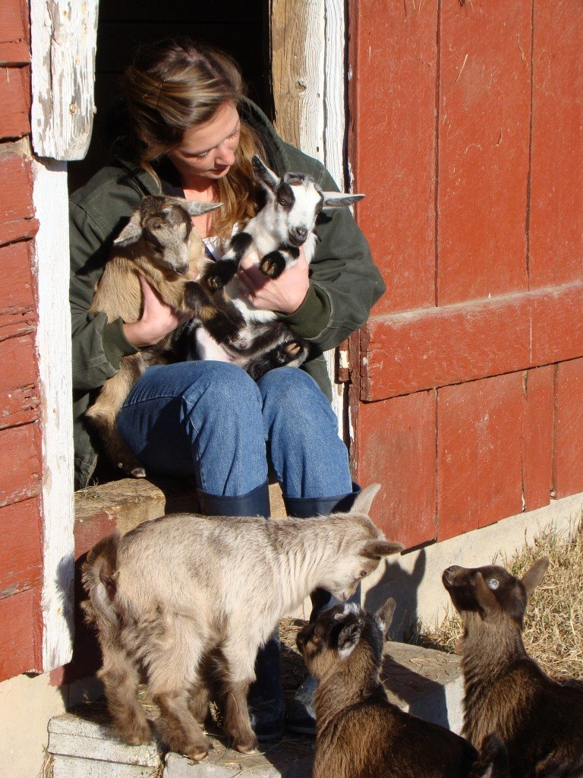
Identifying YOUR unique resources
Avoid replicating other’s “successful” stories.
(But let them inspired you).
Start thinking (& writing) some ideas based on your farm resources.
4 types of resources:
Farmland
Nature
Tangible heritage
The farmer(s)
Agritourism & Societal Well-being Lab
Notes:
5 minutes for all resources

Slide 8
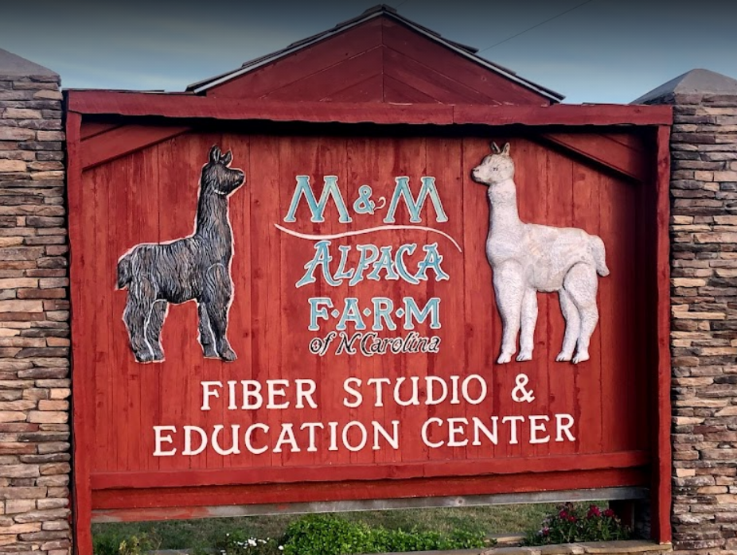
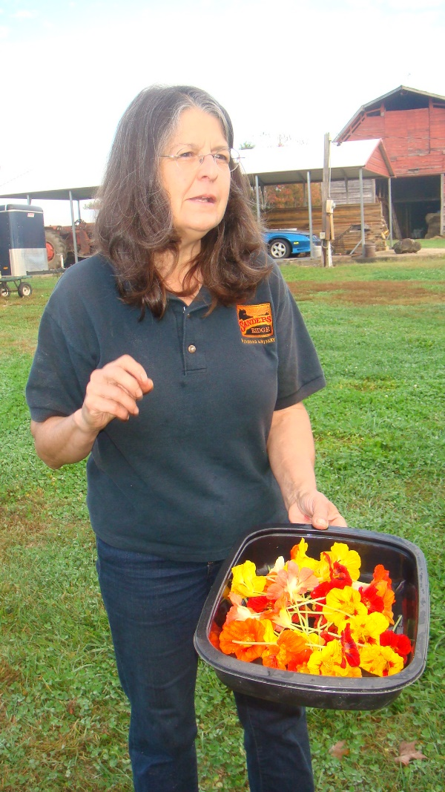
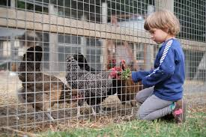
Resources – Farmland
Crops & animals raised.
Value-added products.
Traditional –heirloom– practices & products.
Exotic crops or animals.
Sanders Ridge
(Boonville, NC)
Creekside Farm (Selma, NC) v
Napa Valley (California)
Agritourism & Societal Well-being Lab

Slide 9
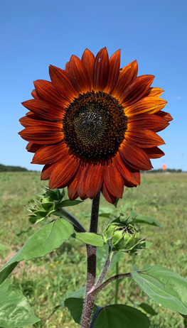
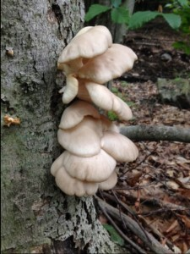
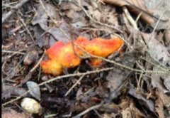
Resources – Nature
Gross Farms
(Sanford, NC)
Wild animals?
Native plants?
Water bodies?
^ Spring Valley Trout Farm (Dexter, MI)
Mushroom Hunting
Golden Stage Inn
< (Proctorsville, VT) >
Lazy O Farm (Smithfield, NC)

Slide 10
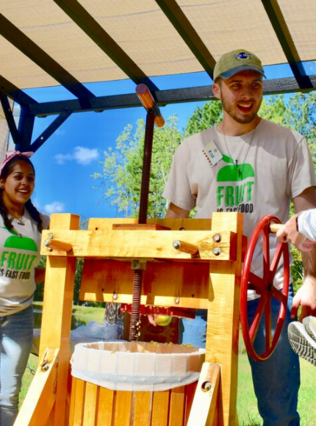
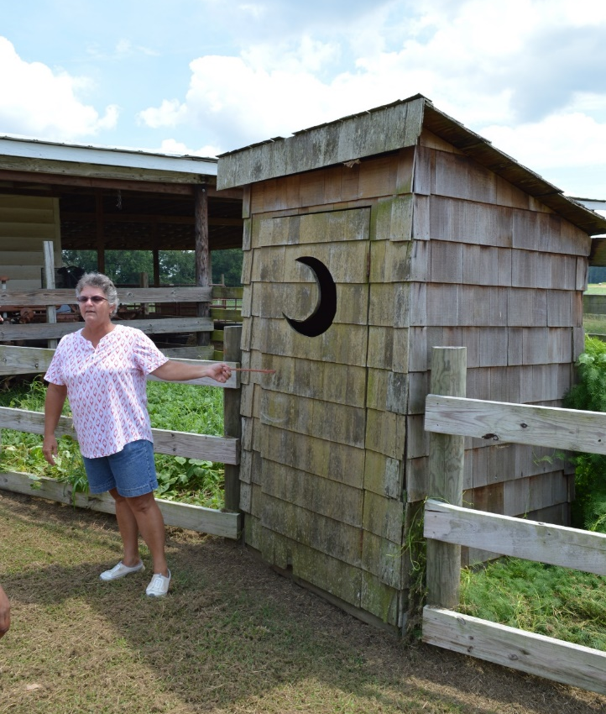
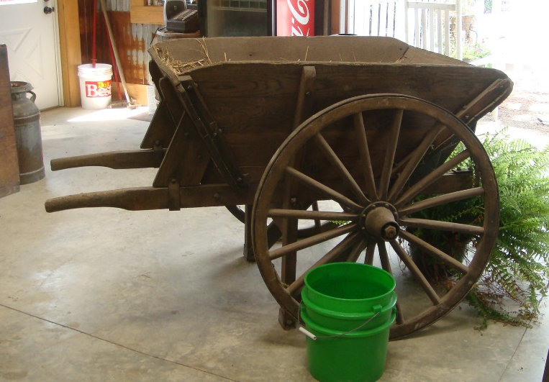
Resources – Tangible Heritage
New & old (repurposing).
Tools, equipment & buildings.
Authentic & staged.
v Millstone Creek Orchards (Ramseur, NC)
^ Lazy O Farm (Smithfield, NC)
^ Ray Family Farm (Louisburg, NC)
Agritourism & Societal Well-being Lab

Slide 11
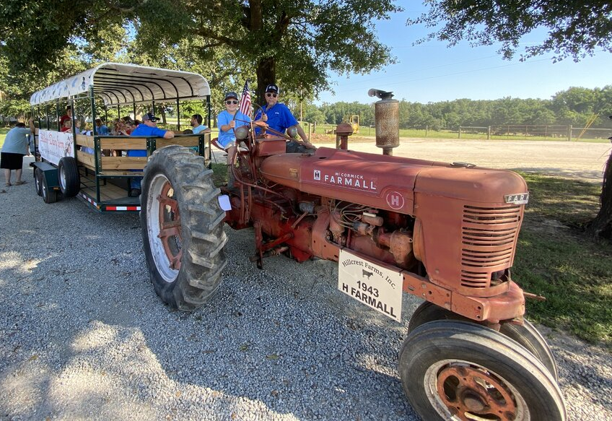
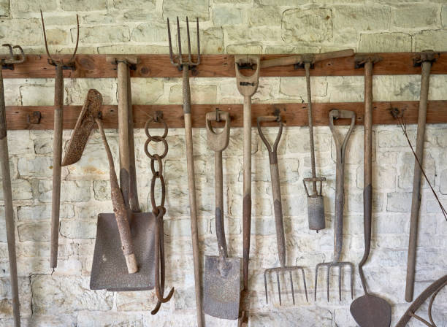
Resources – Tangible Heritage
New & old (repurposing).
Tools, equipment & buildings.
Authentic & staged.
^ Hillcrest Farms (Dearing, GA)
Agritourism & Societal Well-being Lab

Slide 12
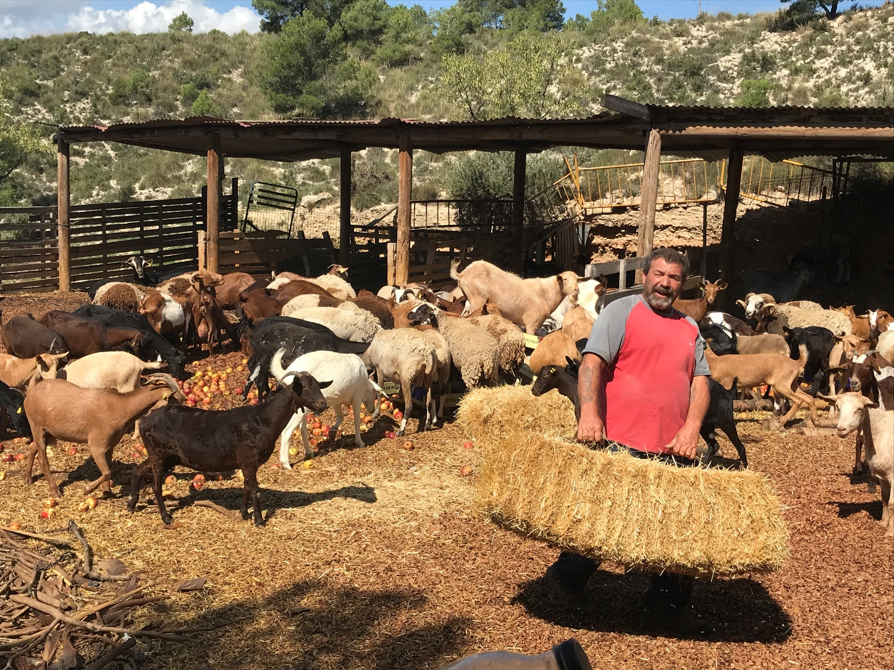
Resources – The Farmer(s)
The farmer(s)
Quesería Tibi
(Alicante, Spain)
Agritourism & Societal Well-being Lab
Notes:
A swiss painter (she) who married a goat farmer… She learned how to make cheese and gives workshops. The guy shows the goats, but charges a fee to go with him to graze them in the traditional way.

Slide 13
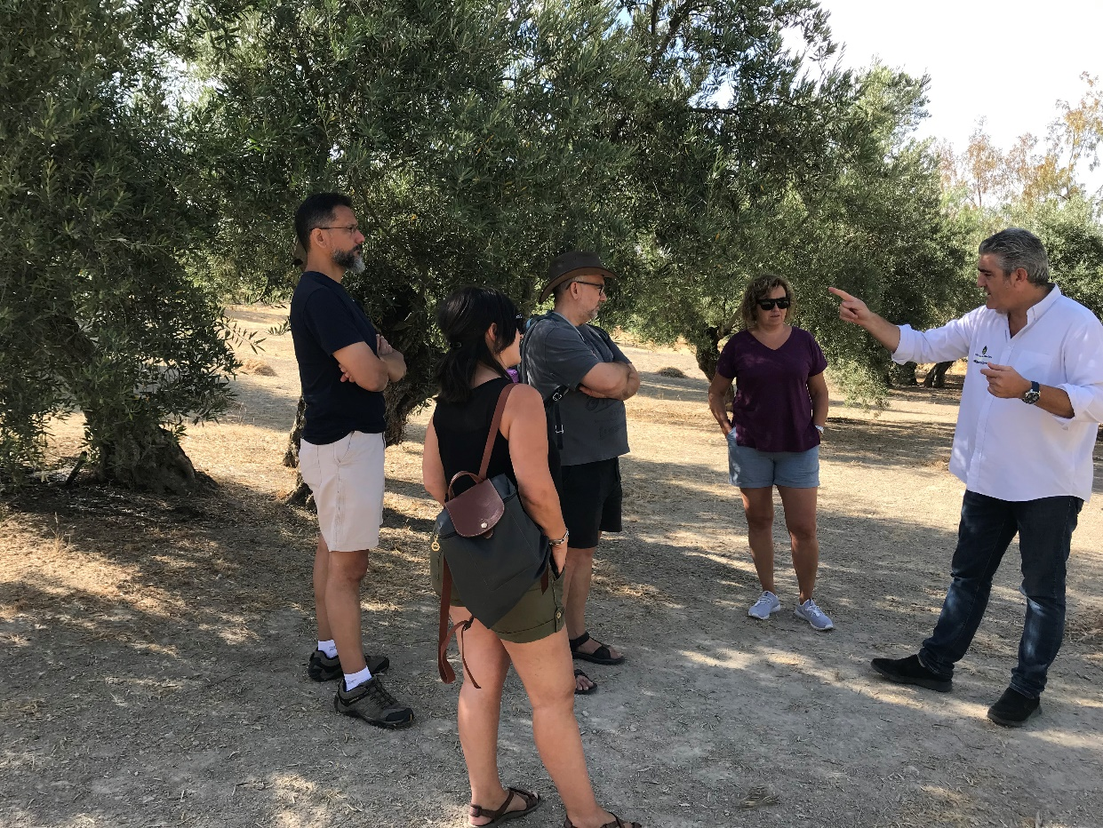
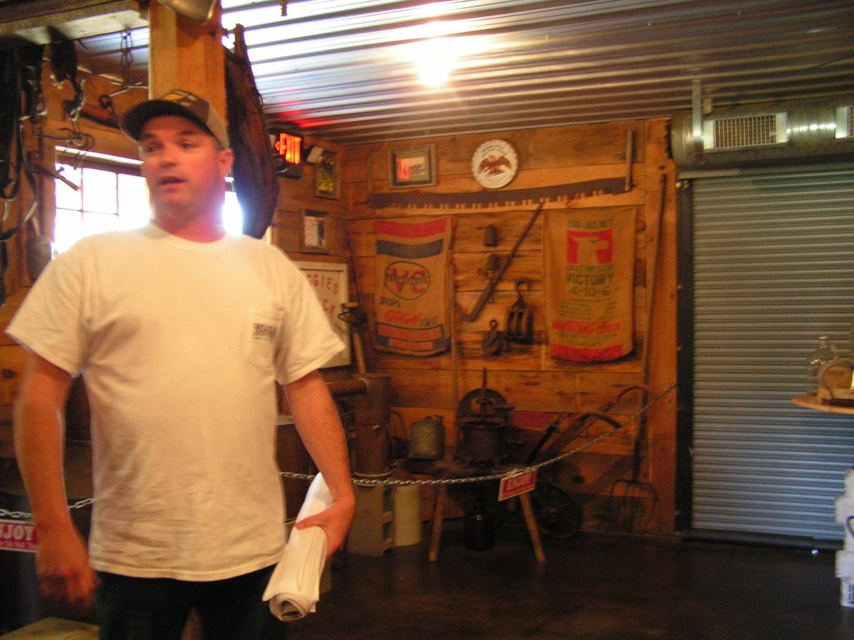
Resources – The Farmer(s)
Entertainers
Story Tellers
Aleícola San Francisco
(Jaen, Spain)
Broadslab Distillery
(Benson, NC)
Lazy O Farm
(Smithfield, NC)
Agritourism & Societal Well-being Lab
Notes:
Lazy O Farm >> do animated songs for kids to learn about agriculture (in this case was something with the ears of the bunnies)

Slide 14
The Uniqueness of Agritourism
Work individually or with other person from your same farm
10 minutes (14:40 – 14:55)
Identify your farm resources
Write them in the flipcharts by type of resource
** If repeated, mark it with a “stick”
Let’s share are resources!
10 minutes (14:55 – 15:05)
Agritourism & Societal Well-being Lab

Slide 15
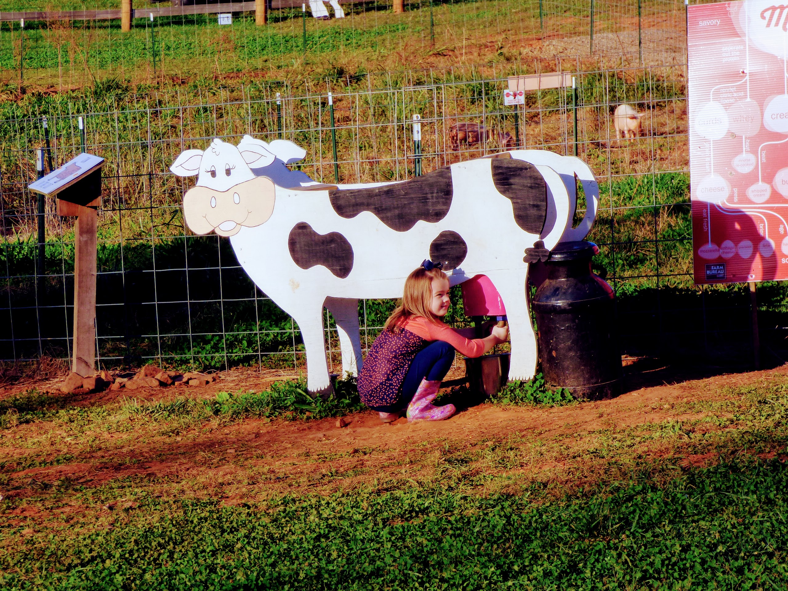
The Entrepreneurial Mindset
Part 2 (15:15 – 15:55)
Background [15:15 – 15:25]
Similar resources
Being creative to offer uniqueness
Activity [15:25 – 15:45]
How will I incorporate creativity into my offerings?
Group sharing [15:45 – 15:55]
Agritourism & Societal Well-being Lab
Notes:
10 minutes – Parar en 15:25

Slide 16
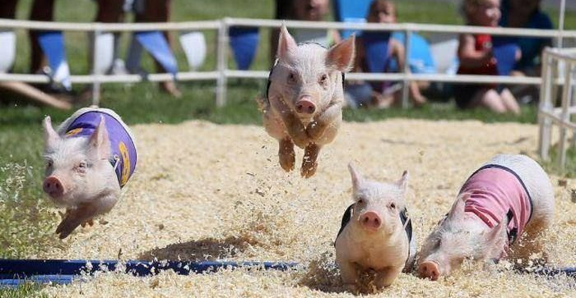
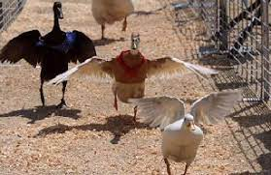
The Entrepreneurial Mindset
Reality Check:
We have similar resources in our locality!
Most common farm animals?
Most common crops?
How do we make our resources UNIQUE?:
Entrepreneurs are…
Resourceful – Use what they have
Innovators
Persistent – Trial & error
Agritourism & Societal Well-being Lab

Slide 17
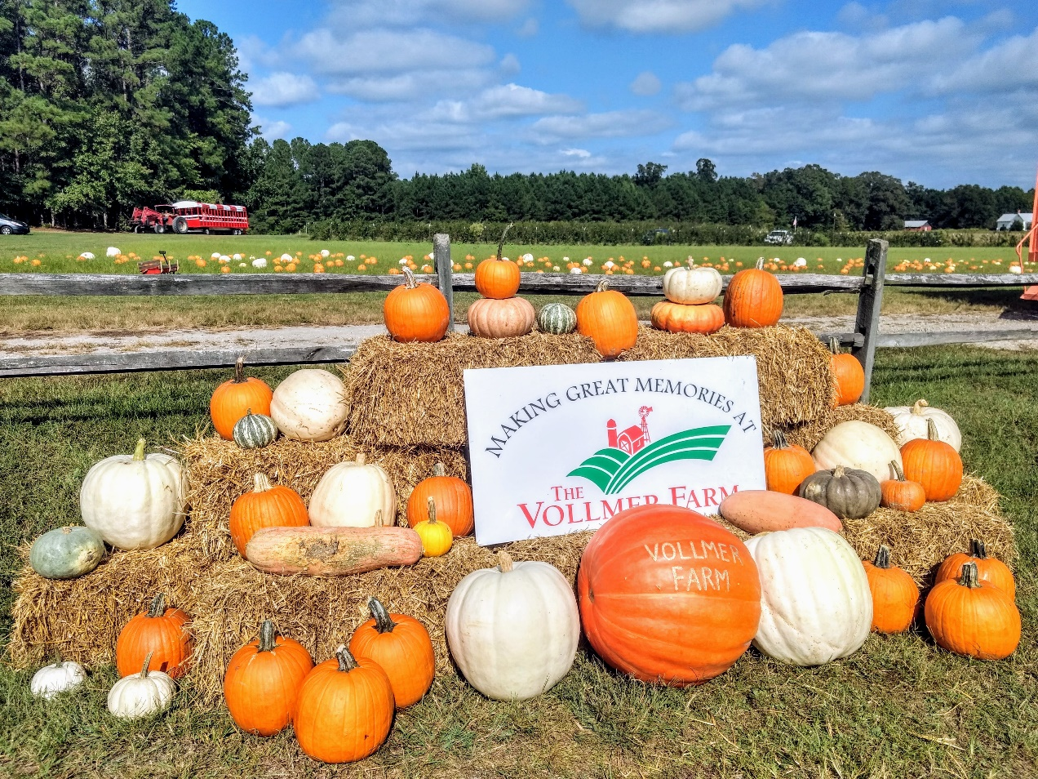
Be Creative…
…To sell other farm or local products!
Vollmer Farm (Bunn, NC)
Agritourism & Societal Well-being Lab

Slide 18
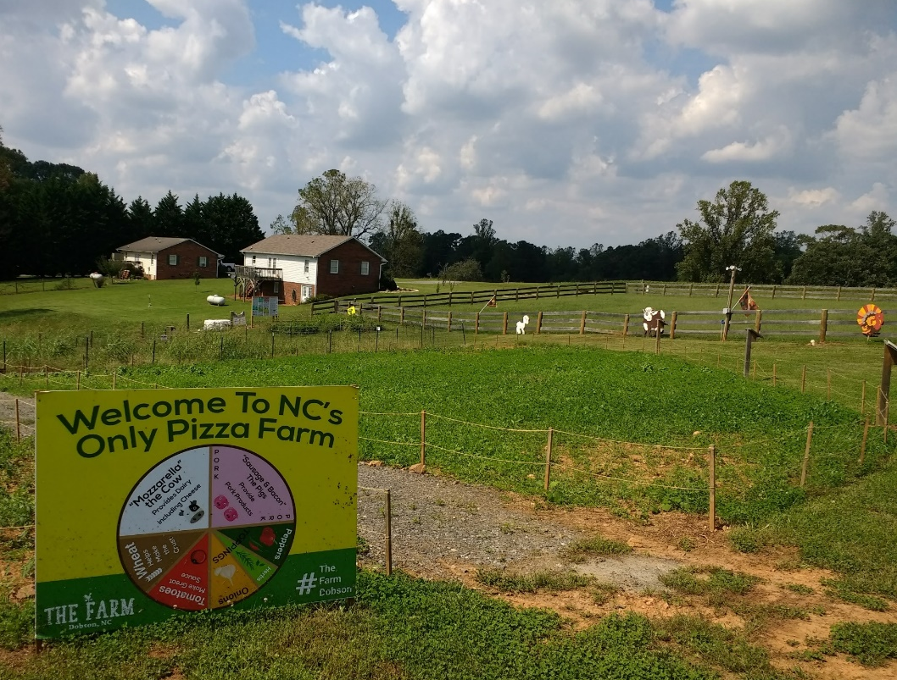
Be Creative…
…To educate visitors!
The Farm (Dobson, NC)
Agritourism & Societal Well-being Lab

Slide 19
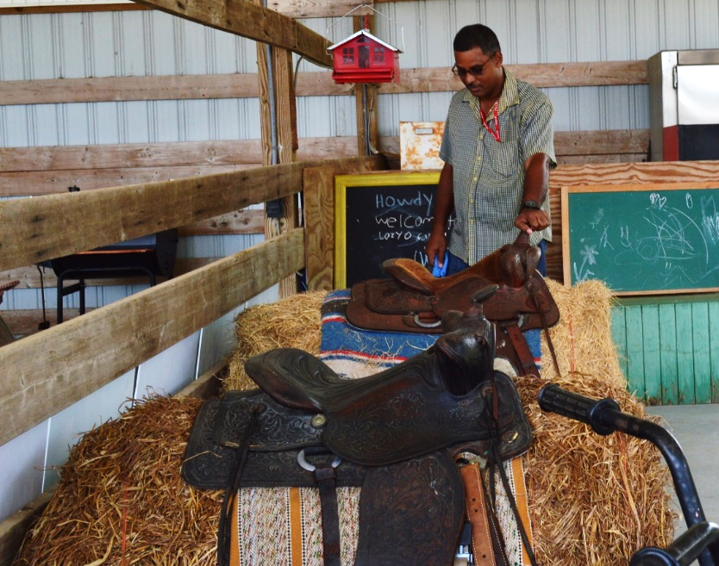
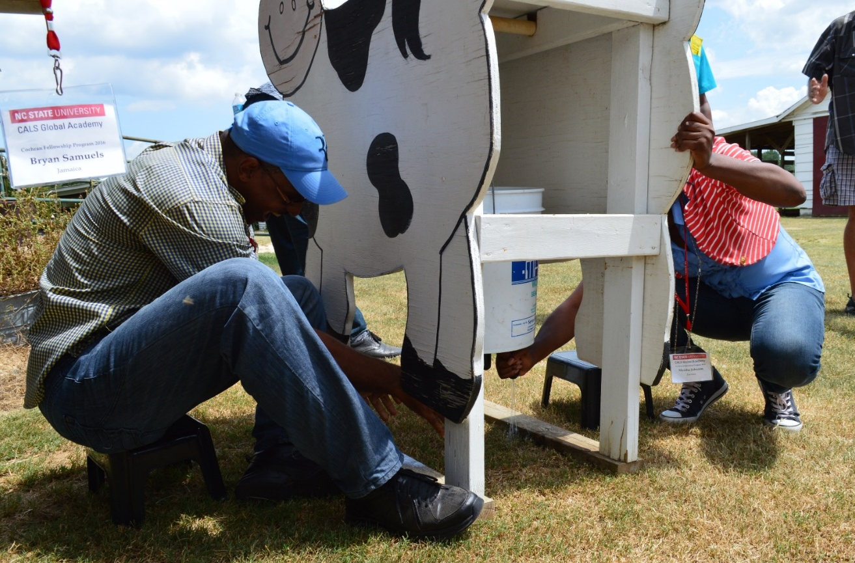
Be Creative…
…To recreate visitors!
Lazy O Farm (Smithfield, NC)
Notes:
How to offer “farm” experiences (horse riding, cow milking) without having the resources or not wanting to offer them for safety.

Slide 20
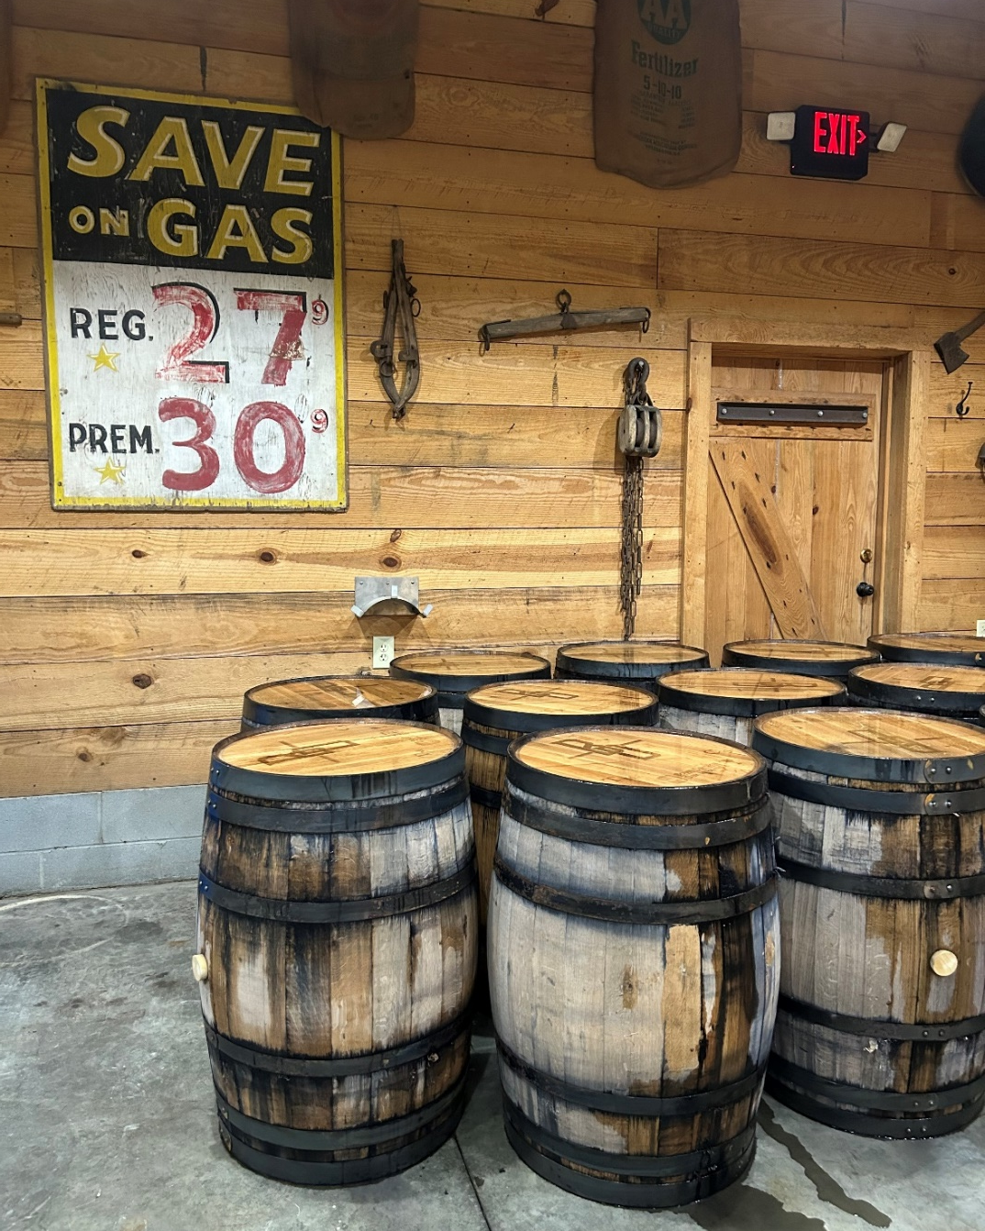
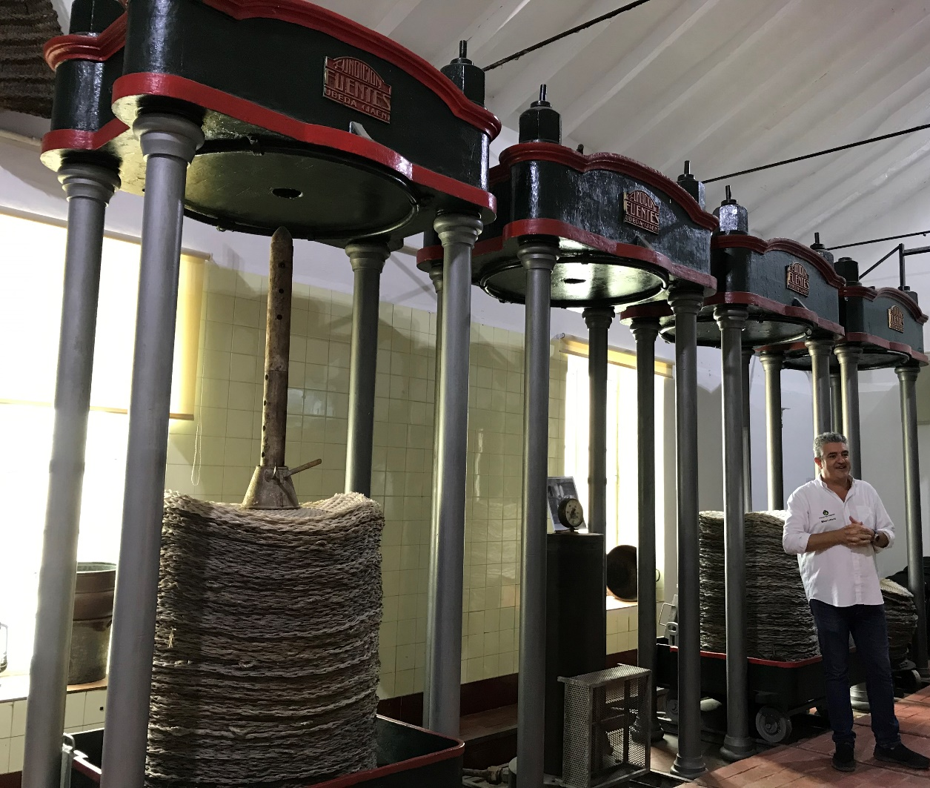
Be Creative…
Broadslab Distillery (Benson, NC)
…To increase the visual appeal (décor)!
Evoking nostalgia…
Aleícola San Francisco (Jaen, Spain)
Notes:
Evoking nostalgia with little investments!

Slide 21
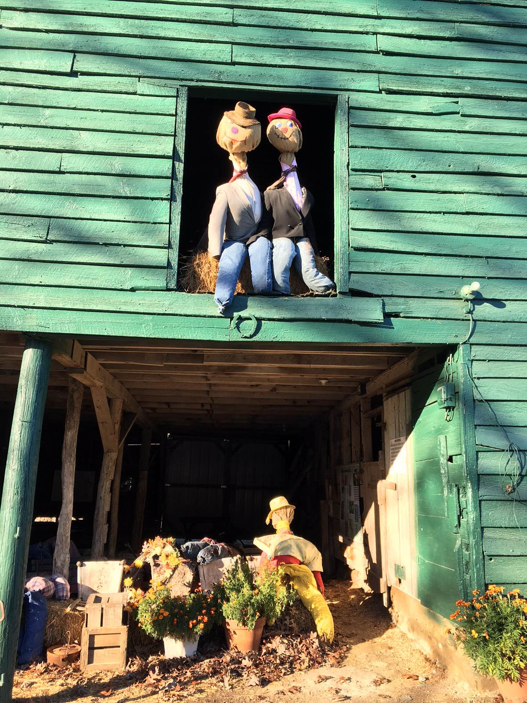
Be Creative…
Mayberry Spirits (Mount Airy, NC)
…with little economic investments
El Capriolo (Madrid, Spain)
Stepp’s Hillcrest Orchard (Hendersonville, NC)
Agritourism & Societal Well-being Lab
Notes:
Evo

Slide 22
The Entrepreneurial Mindset
How will you incorporate creativity into my offerings?
Work in small groups (3-4) with people with different types of resources
20 minutes (15:25 – 15:45)
Debate with your peers how you will differentiate your resources from theirs.
Let’s share our creativity!
10 minutes (15:45 – 15:55)
Agritourism & Societal Well-being Lab

Slide 23
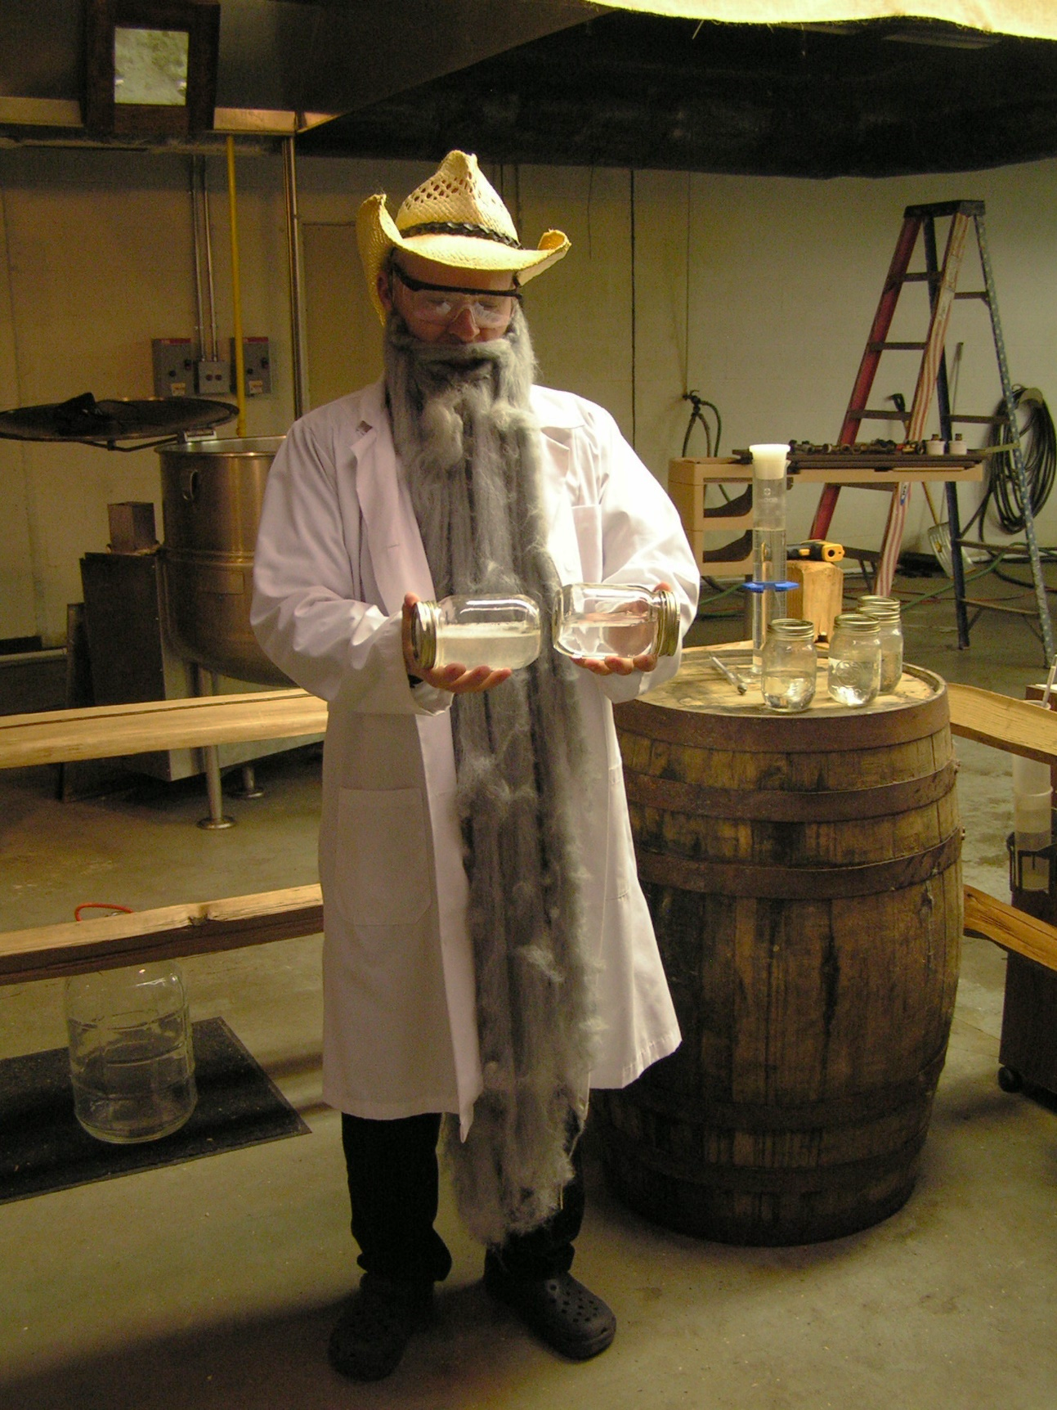
Creating & Selling My Story
Part 3 (16:00 – 16:40)
Background [16:00 – 16:10]
The elements of good story
Some tips & examples
Activity [16:10 – 16:25]
What is MY story?
Group sharing [16:25 – 16:35]
Agritourism & Societal Well-being Lab

Slide 24
Crafting a Good Story
Quesería Tibi
(Alicante, Spain)
It needs a basic plot:
Hero (or heroine)
Challenge or obstacle
Action with a purpose
Resolution (the end) with a meaning.
(Appalachian Sustainable Agriculture Project – ASAP, 2016)
Agritourism & Societal Well-being Lab
Notes:
The importance of resources to build a unique story

Slide 25
Crafting a Good Story
It needs a basic plot:
Hero (or heroine)
Challenge or obstacle
Action with a purpose
Resolution (the end) with a meaning.
Aleícola San Francisco
(Jaen, Spain)
(Appalachian Sustainable Agriculture Project – ASAP, 2016)
Agritourism & Societal Well-being Lab
Notes:
The importance of resources to build a unique story

Slide 26
Crafting a Good Story
It needs a basic plot:
Hero (or heroine)
Challenge or obstacle
Action with a purpose
Resolution (the end) with a meaning.
Broadslab Distillery
(Benson, NC)
(Appalachian Sustainable Agriculture Project – ASAP, 2016)
Agritourism & Societal Well-being Lab
Notes:
The importance of resources to build a unique story

Slide 27
Creating & Selling My Story
It needs a basic plot:
Hero
Challenge or obstacle
Action with a purpose
Resolution (the end) with a meaning
Some tips:
It is short & focused (3 – 5 minutes)
It is not a series of events
Do not add extra information
Practice it & repeat it in the same way
(Appalachian Sustainable Agriculture Project – ASAP, 2016)

Slide 28
Creating & Selling My Story
What is MY story?
Work in pairs (16:10 – 16:25).
5 minutes: Think about your hero & story
10 minutes: Discuss it with your peer.
Let’s share our story!
10 minutes (16:25 – 16:35)
(Appalachian Sustainable Agriculture Project – ASAP, 2016)

Slide 29
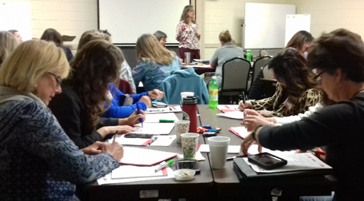
From Competition to Coopetition
Part 4 (16:45 – 17:25)
Background [16:45 – 16:55]
Building partnerships
2 scenarios
Activity [16:55 – 17:10]
Who could be my local/regional coopetitors?
Group sharing [17:10 – 17:25]
Agritourism & Societal Well-being Lab

Slide 30
From Competition to Coopetition
Coopetition = Cooperation + Competition
Think about…
Your neighbor as your partner rather than competitor.
Complementary services & attractions.
2 scenarios: Similar & Different products.
Agritourism & Societal Well-being Lab

Slide 31
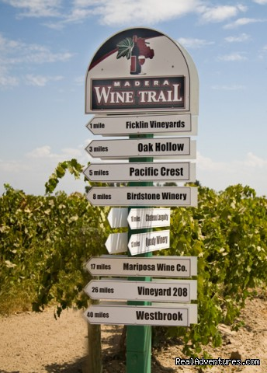
From Competition to Coopetition
Scenario 1 – Similar Products
How is my ‘winery’ different from my neighbors’?
Individual identity
Unique offerings
Agritourism & Societal Well-being Lab

Slide 32
From Competition to Coopetition
Scenario 1 – Similar Products
Boutique – 1000 cases
How is my ‘winery’ different from my neighbors’?
Individual identity:
Sustainable Farming
Windsor Run
The Swan Creek Wine Trail offers you four vineyards, all within 5 miles of one another.
Wine, Mead & Spirits
These wineries specialize in varietal wines and blends (…) but each maintains its own atmosphere and winemaking approach.
Fine Wines.
No Snobbery

Slide 33
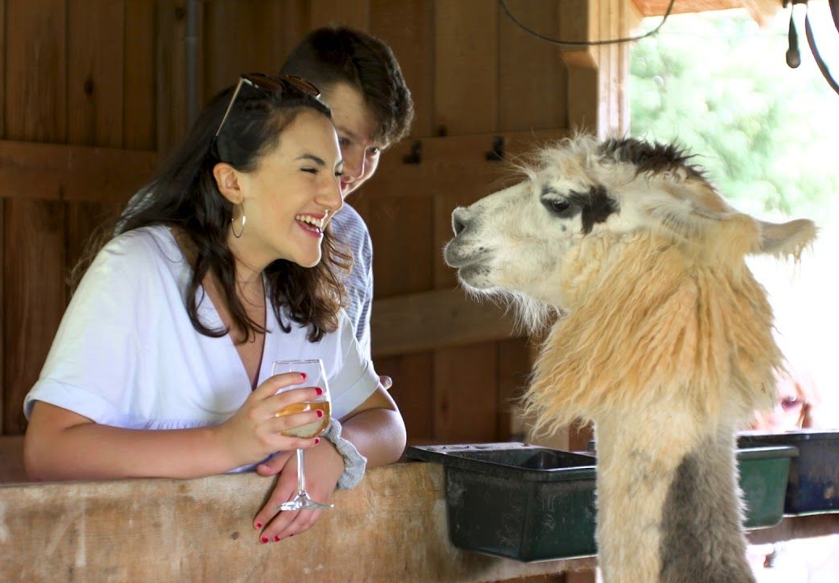
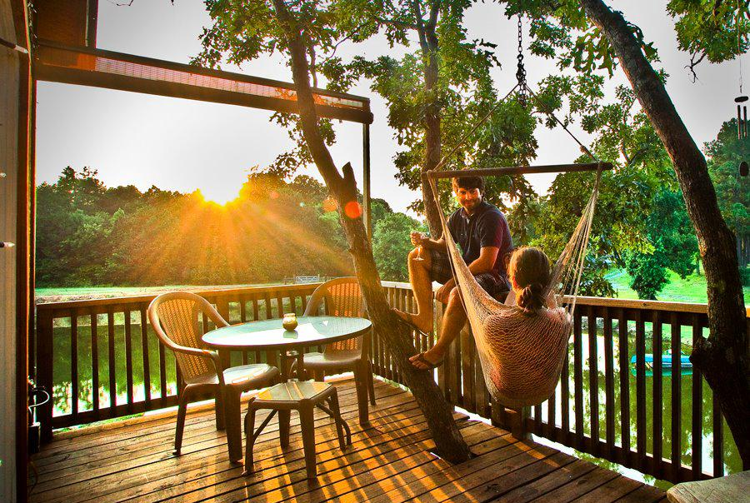
From Competition to Coopetition
Scenario 1 – Similar Products
How is my ‘winery’ different from my neighbors’?
Divine Llama Vineyards (East Bend, NC)
Unique offerings: (Going beyond tasting)
Wine pairing classes (cooking, cheese…)
Outdoor recreation
Specialty ingredients or processes
Special events & stays
Treehouse Vineyards (Monroe, NC)

Slide 34
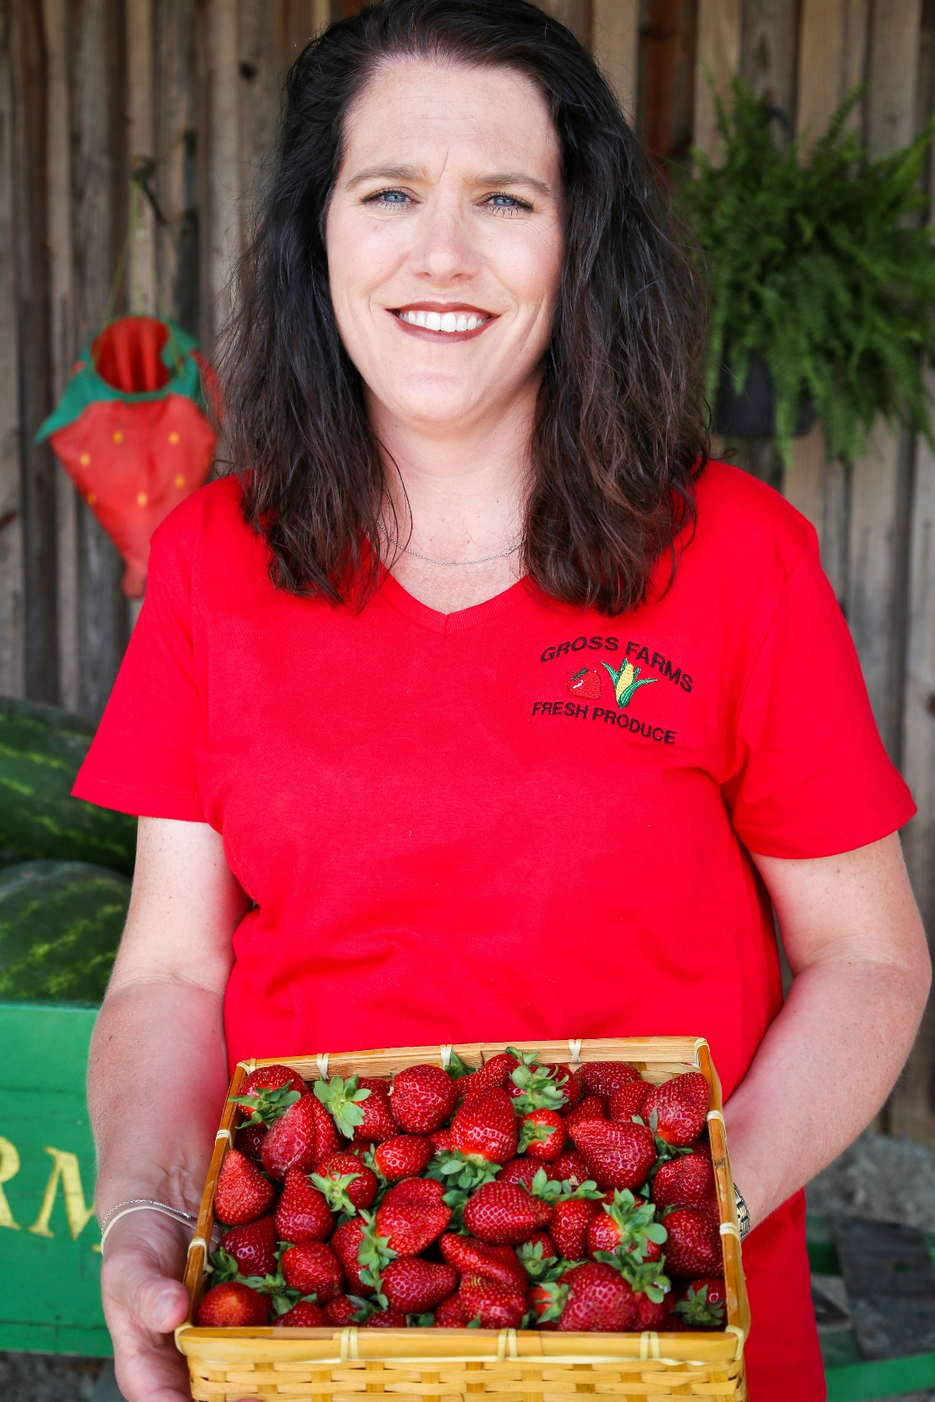
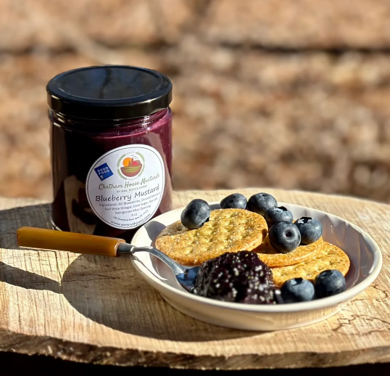
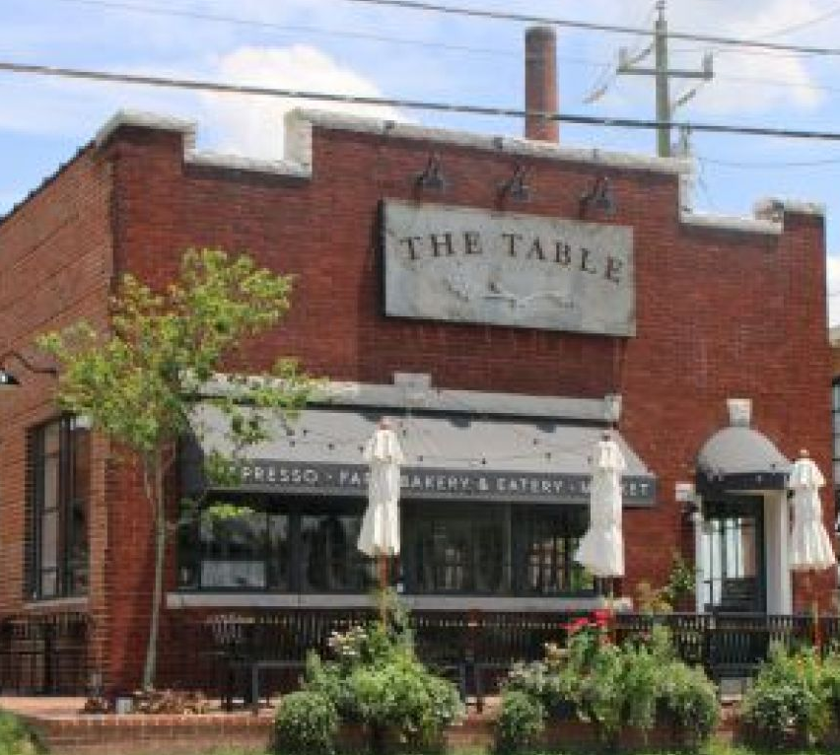
From Competition to Coopetition
Scenario 2 – Different Offerings
A few local partners (neighbors)
The Table Farmhouse Bakery (Asheboro, NC)
Mrs. Ruth's Jams (Processes local foods)

Slide 35
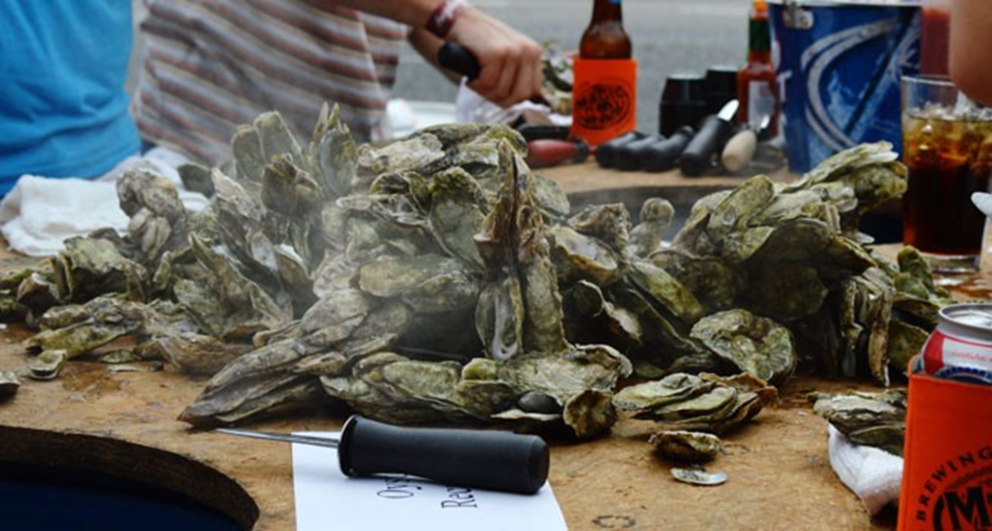
From Competition to Coopetition
Scenario 2 – Different Offerings
A destination collaboration…
Key – Having a shared theme!
Natural or lifestyle heritage (e.g., The Appalachian)
Health or sustainability
And even a product.
Agritourism & Societal Well-being Lab
Notes:
These usually take more effort, but they are doable.
So, let me share a major collaboration that started in NC around 1 product: Oysters.

Slide 36
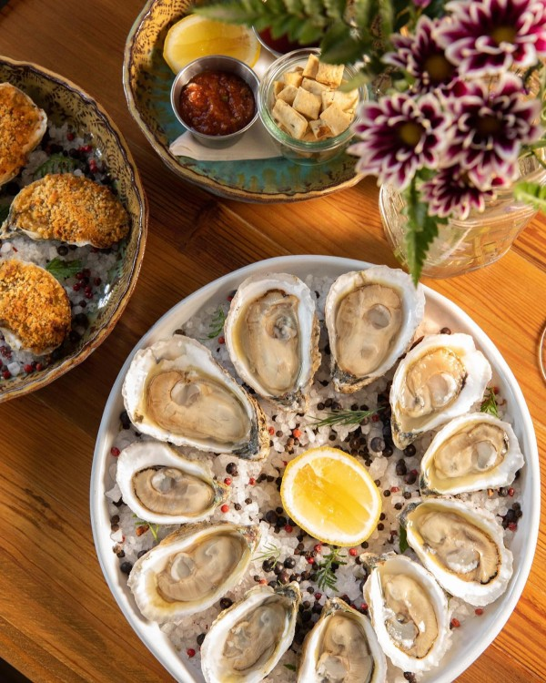
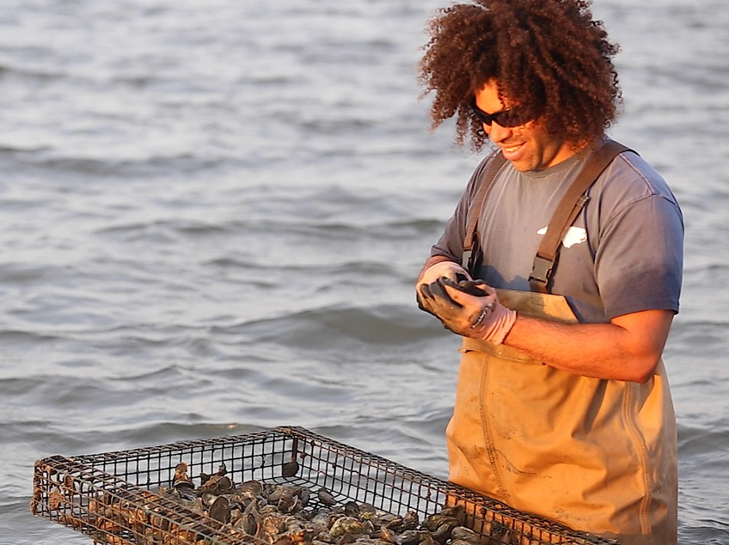
From Competition to Coopetition
Scenario 2 – Different Offerings
75 members throughout NC
Growers/harvesters
Restaurants
Markets
Educational experiences
Agritourism & Societal Well-being Lab
Notes:
Started with the farmers

Slide 37
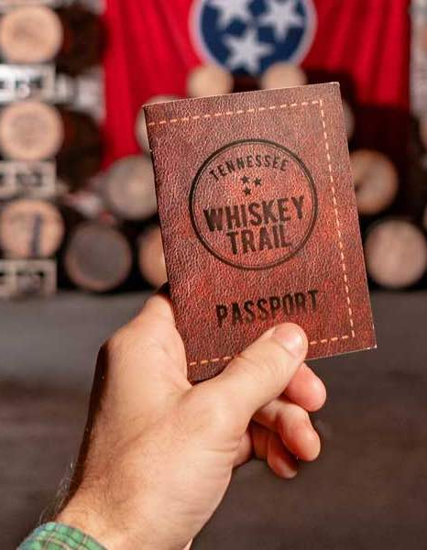
From Competition to Coopetition
WHO could be OUR local/regional coopetitors?
Groups of 4-5 nearby (local) neighbors (16:55 – 17:10).
15 minutes: Identify the potential local coopetitors
Write their name & type of business.
Let’s share our competitors!
10 minutes (17:10 – 17:25)
Agritourism & Societal Well-being Lab

Slide 38
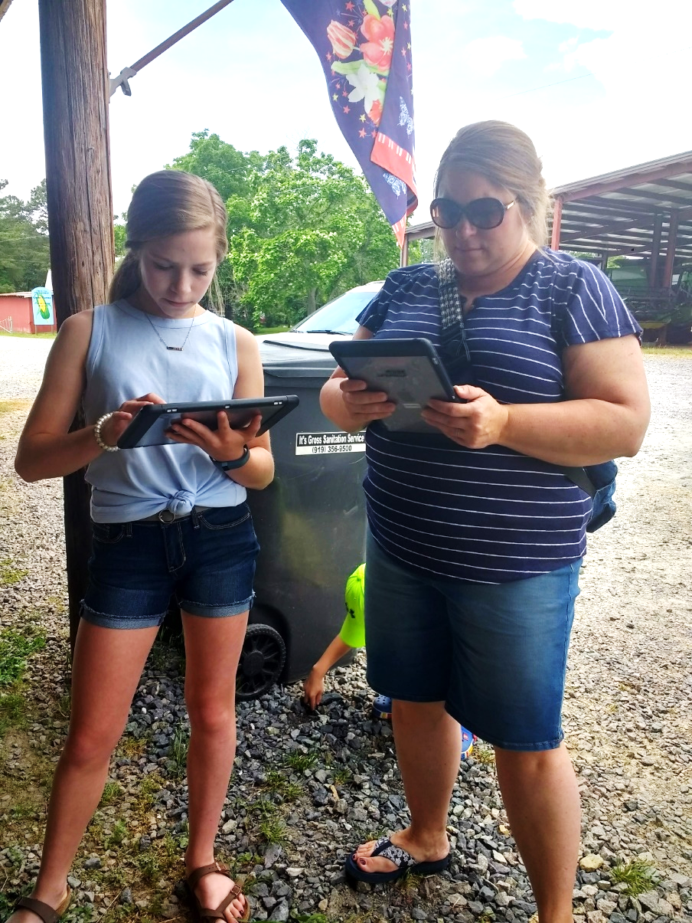
Wrapping Up
Part 5 (17:30 – 18:15)
Summary [17:30 – 17:40]
Putting all pieces together
Activity [17:40 – 17:50]
My key learnings
Group sharing [17:50 – 18:10]
Agritourism & Societal Well-being Lab

Slide 39
What is Agritourism?
Activities carried out in working farms or other agricultural settings for leisure, recreation or education.
(Gil Arroyo, Barbieri & Rich, 2013)
Agritourism & Societal Well-being Lab
Notes:
Recap of agritourism – 5 minutes

Slide 40
Agritourism as an Ag Enterprise
Enterprises developed on the farm to increase farm revenues or value.
Eight types of enterprises
Value
Added
Non Traditional Farming
2. Synergistic nature
Education
Innovative Marketing
Average: 3.8
Contracts & Services
3. Agritourism:
Constant expansion
Flexibility based on farm resources
Agritourism
Leases & Time Shares
Historic Preservation & Re-use
Barbieri et al., 2008
Agritourism & Societal Well-being Lab
Notes:
You can –or should– tie your agritourism to other on-farm enterprises you might have.

Slide 41
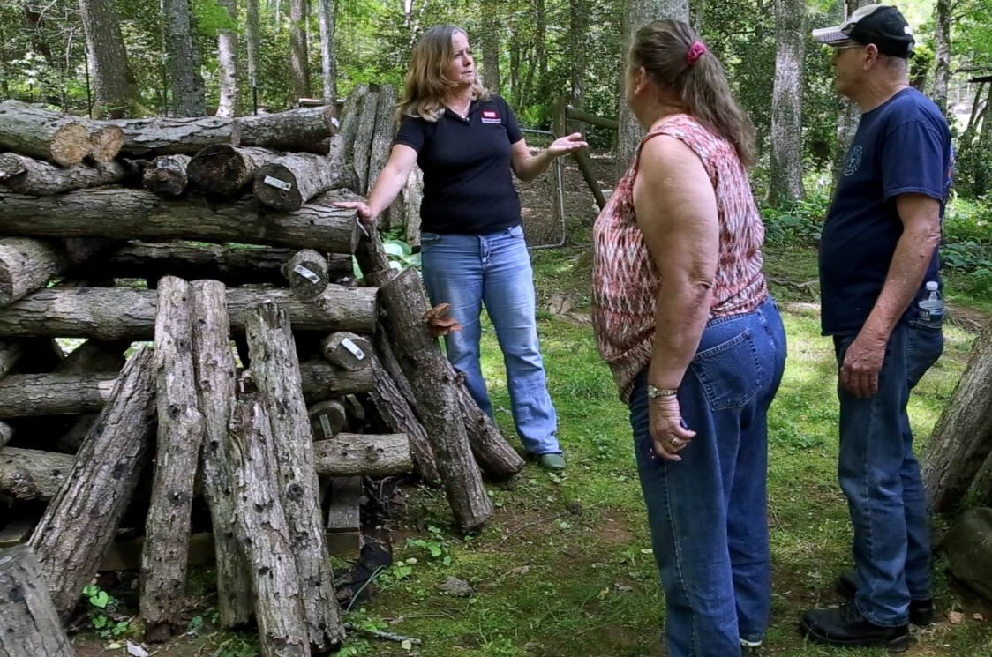
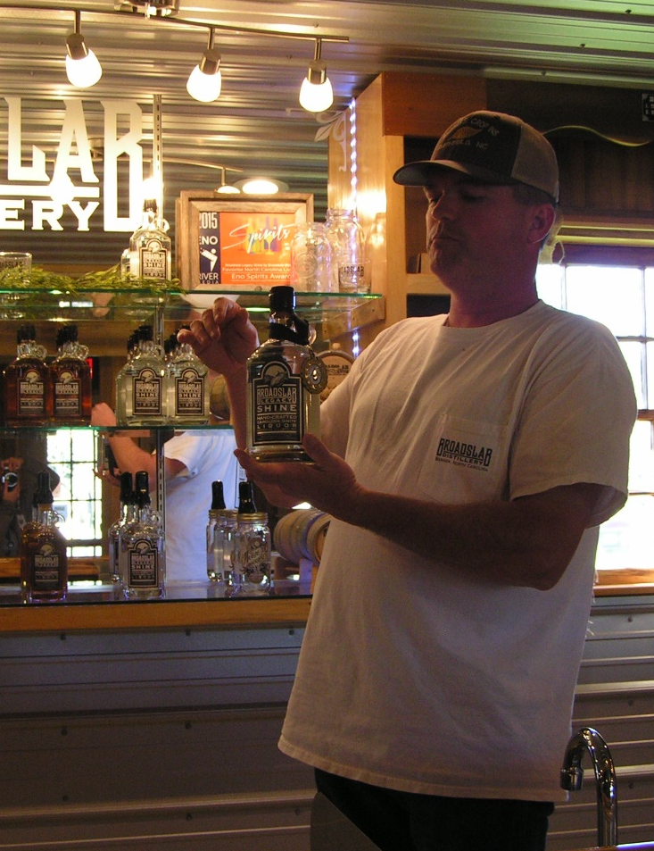
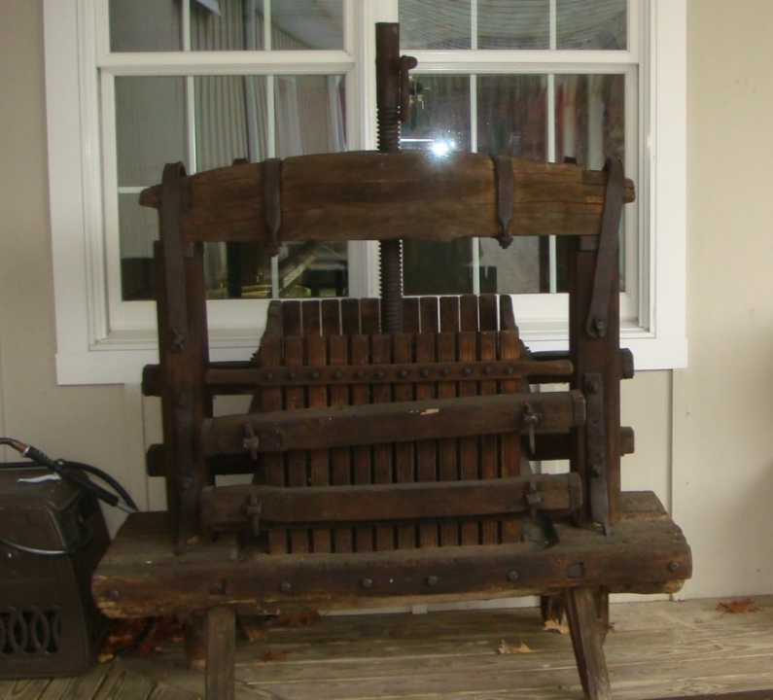
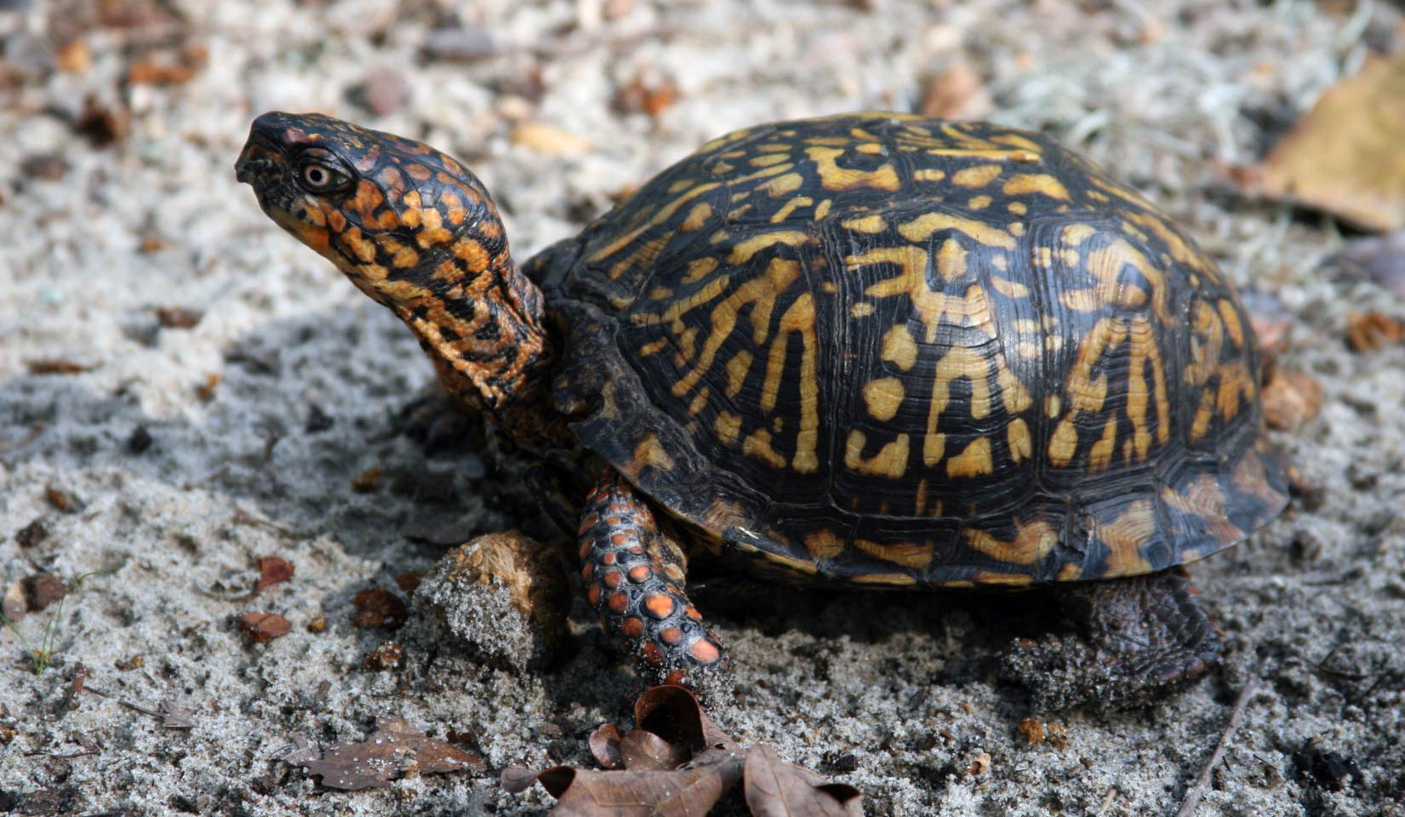
The Uniqueness of Agritourism
Brothers on Farm (Hayersville, NC)
Is based on 4 types of resources:
Farmland
Nature
Tangible heritage
The farmer(s)
Veritas Vineyard & Winery (Nelson, VA)
Broadslab Distillery (Benson, NC)
Agritourism & Societal Well-being Lab
Notes:
5 minutes for all resources

Slide 42
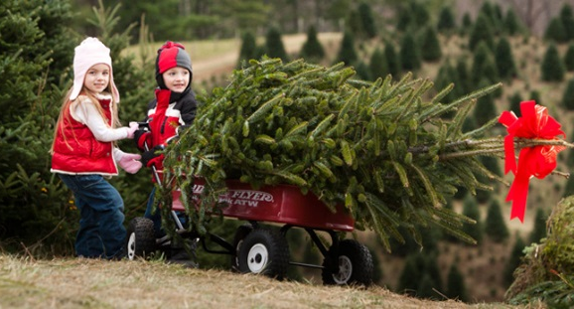
Agritourism Needs Creativity
To…
Sell other farm or local products
Educate & recreate visitors
Increase the farm visual appeal (décor)
Agritourism & Societal Well-being Lab
Notes:
5 minutes for all resources

Slide 43
Agritourism Providers Need to Create & Sell a Story
It needs a basic plot:
Hero
Challenge or obstacle
Action with a purpose
Resolution (the end) with a meaning.
That is…
Short & focused
Consistent.
Agritourism & Societal Well-being Lab
Notes:
5 minutes for all resources

Slide 44
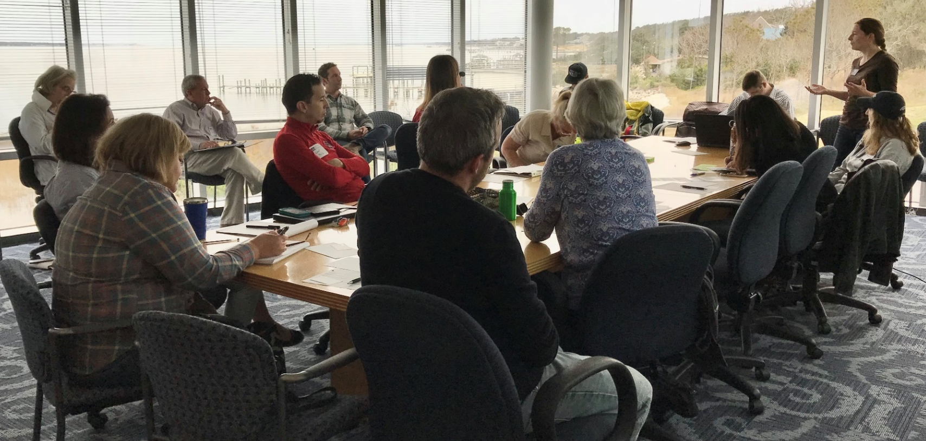
Agritourism Providers Need to
Shift from Competition to Coopetition
1) Similar product providers:
Strategic Partnerships
Having an individual identity
Developing unique offerings.
2) Different product providers:
Having complementary offerings
Identifying a shared theme.
Agritourism & Societal Well-being Lab
Notes:
Strategi Parnershp

Slide 45
Wrapping Up
What is my key learning?
Work individually (17:40 – 17:50).
[10 min] > Think about what is the main take away you will use in your ag business
Let’s share our learnings!
20 minutes (17:50 – 18:10)
Agritourism & Societal Well-being Lab

Slide 46
Thank You!
Carla Barbieri, PhD
Jose Cisneros
carla_Barbieri@ncsu.edu
jose_Cisneros@ncsu.edu
Agritourism & Societal Well-being Lab
College of Natural Resources
CALS International Program
College of Agriculture and Life Sciences
Ag Entrepreneurship Workshop
April 25, 2023
Mostar, Bosnia and Herzegovina

